Slide 1
RoadCrash Guard

Slide 2
Problem Statement
Road safety remains a critical concern in Victoria, with high accident rates posing significant risks to drivers, pedestrians, and cyclists. Despite advancements in vehicle technology and road infrastructure, several challenges persist:
High Accident Rates: The frequency of road accidents continues to be alarmingly high, leading to fatalities, injuries, and substantial economic costs.
Human Factors: Distracted driving, speeding, driving under the influence, and driver fatigue are major contributors to road accidents.
Infrastructure Deficiencies: Poor road conditions, inadequate lighting, and lack of dedicated infrastructure for pedestrians and cyclists increase the risk of accidents.
Environmental Conditions: Adverse weather conditions and seasonal variations further exacerbate the risk of road accidents.
Data Gaps: Inconsistent data collection and underreporting of accidents hinder effective analysis and policy-making.
Policy and Enforcement: Inconsistent enforcement of traffic laws and outdated regulations impede efforts to improve road safety.
Addressing these challenges requires a comprehensive, data-driven approach to identify high-risk areas, understand the underlying causes of accidents, and formulate effective strategies for prevention. The goal is to enhance road safety for all users, from pedestrians to drivers, through actionable insights and evidence-based policies.

Slide 3
Our Solution – RoadCrash Guard
Improving road safety is not just a matter of preventing accidents; it’s about creating a safer, healthier, and more prosperous society. By addressing the causes of road accidents and implementing effective safety measures, we can protect lives, reduce economic costs, and enhance the quality of life for everyone.
Based on our analysis , below is our objective.
Our Goals for RoadCrash Guard:
Develop a web page to pinpoint all crash hotspots in Victoria with filters to indicate the vehicle type, road conditions and atmospheric conditions.
Generate comprehensive and concise executive briefs summarizing our findings, insights, and recommendations for government officials.
Create a mobile application to enhance road safety for users such as pedestrians, bicyclists, motorcyclists, drivers, and passengers, based on their current location.
The key differentiator is the feeding in of recent data on a weekly basis, to enhance the prediction capability of the AI system.

Slide 4
Solution Overview
RoadCrash Guard is a responsive AI based solution designed to predict high-risk crash hotspot locations using Victoria Crash data. The solution will predominantly use three channels.
A website that can provide a summary of road crashes on the Victoria map, with filters for various parameters involved in the crash.
An end user mobile application, that can notify and warn users of a road crash risk based on their real time location.
An agent that generates comprehensive and concise executive briefs that summarize key findings, insights, and recommendations.
Recommendation Analysis Parameters:
Latitude and Longitude of the accident spot
Road/Street name
Road condition
Intersection type
Atmospheric condition
Vehicle type and age

Slide 5
Technical Architecture - Tech Stack
React Navigation
Push Notification
React Native
Map
Map
React
Next.js
MobileTechstack
Website Techstack
Node.js
Python
AWS Lambda
AWS
EC2
BackendTechstack

Slide 6
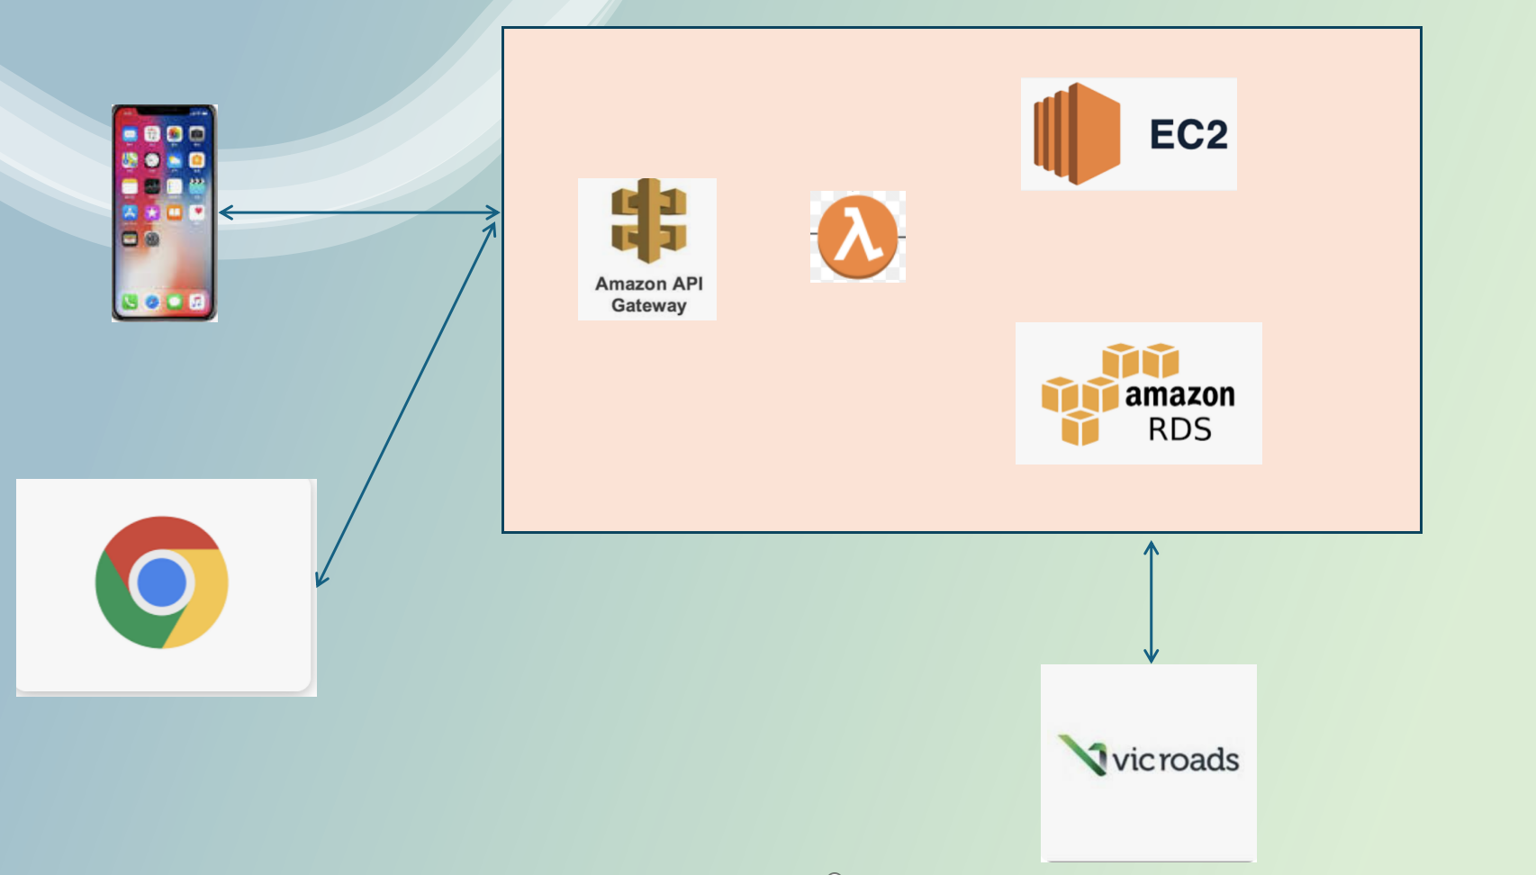
Technical Architecture
The solution uses react, react native and maps
at the front end. The front end leverages
ReST APIs hosted in AWS infrastructure.
Python ML (Agent 1) will be run in EC2 and critical
information is aggregated into RDS(or noSQL TBD)
This aggregated information is read via lambda
when an API call is made.
Another API is used to receive feedback from
VicRoads to enhance the model in future as new data sets
are received.
EC2 will have a open source mail creator AI agent(Agent 2) which will leverage the data generated by the Agent 1. This data is fed back to a No SQL DB and then sent via SES to interested parties. A config file can be used to configure email address of interested parties

Slide 7
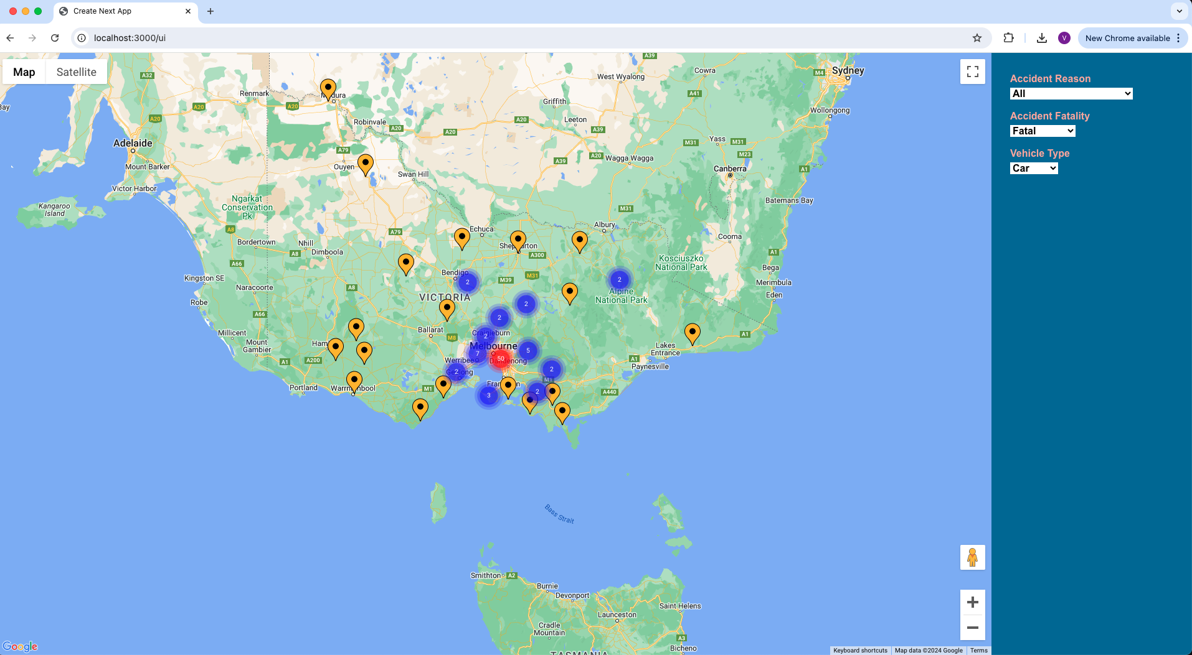
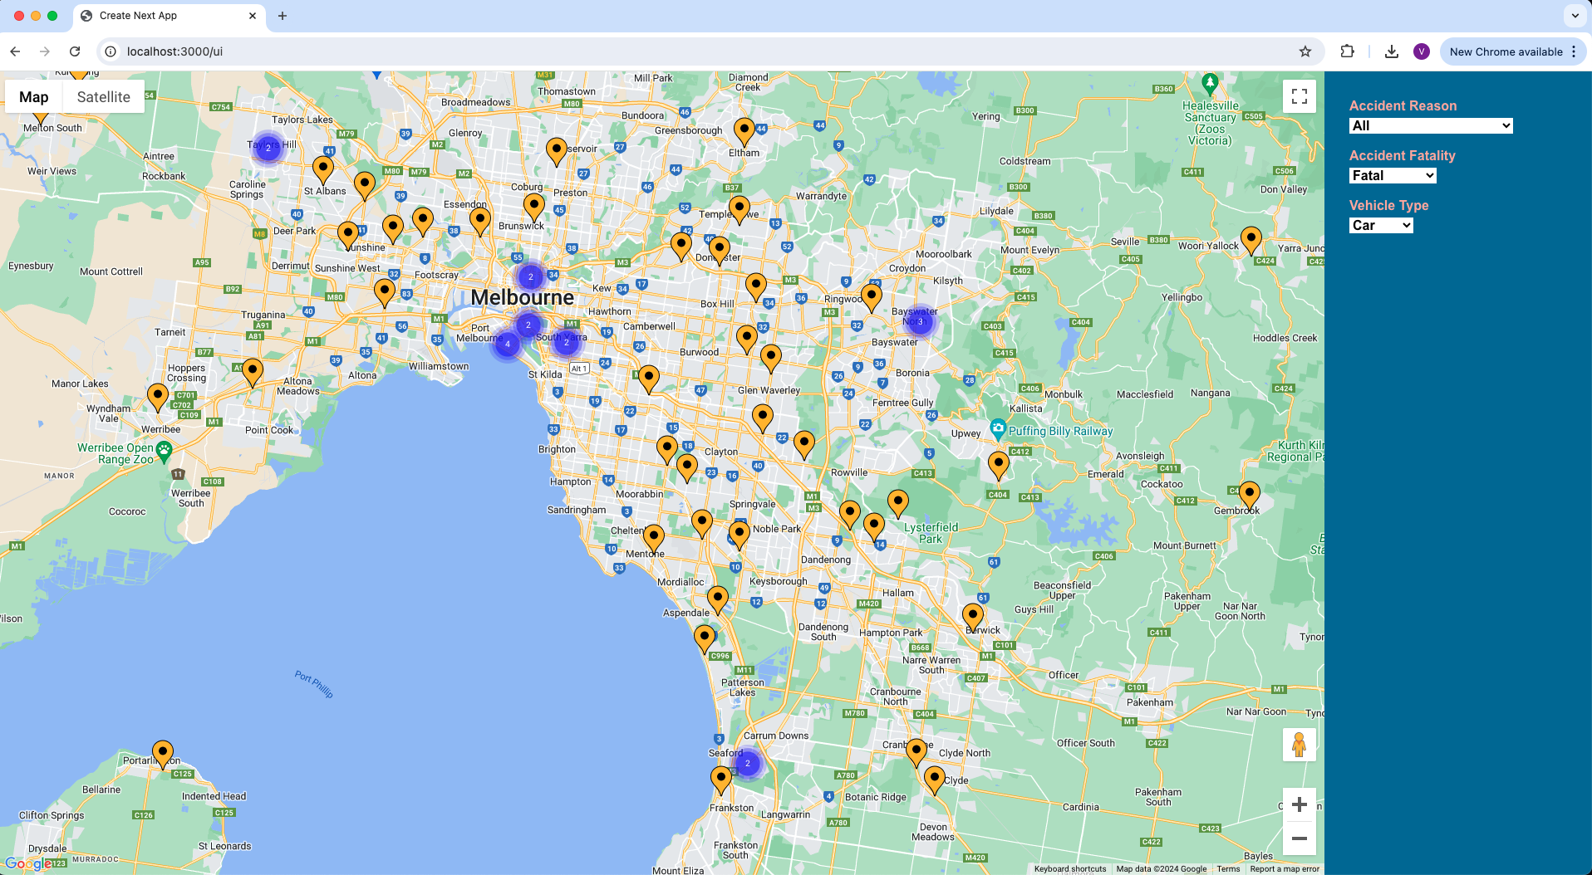
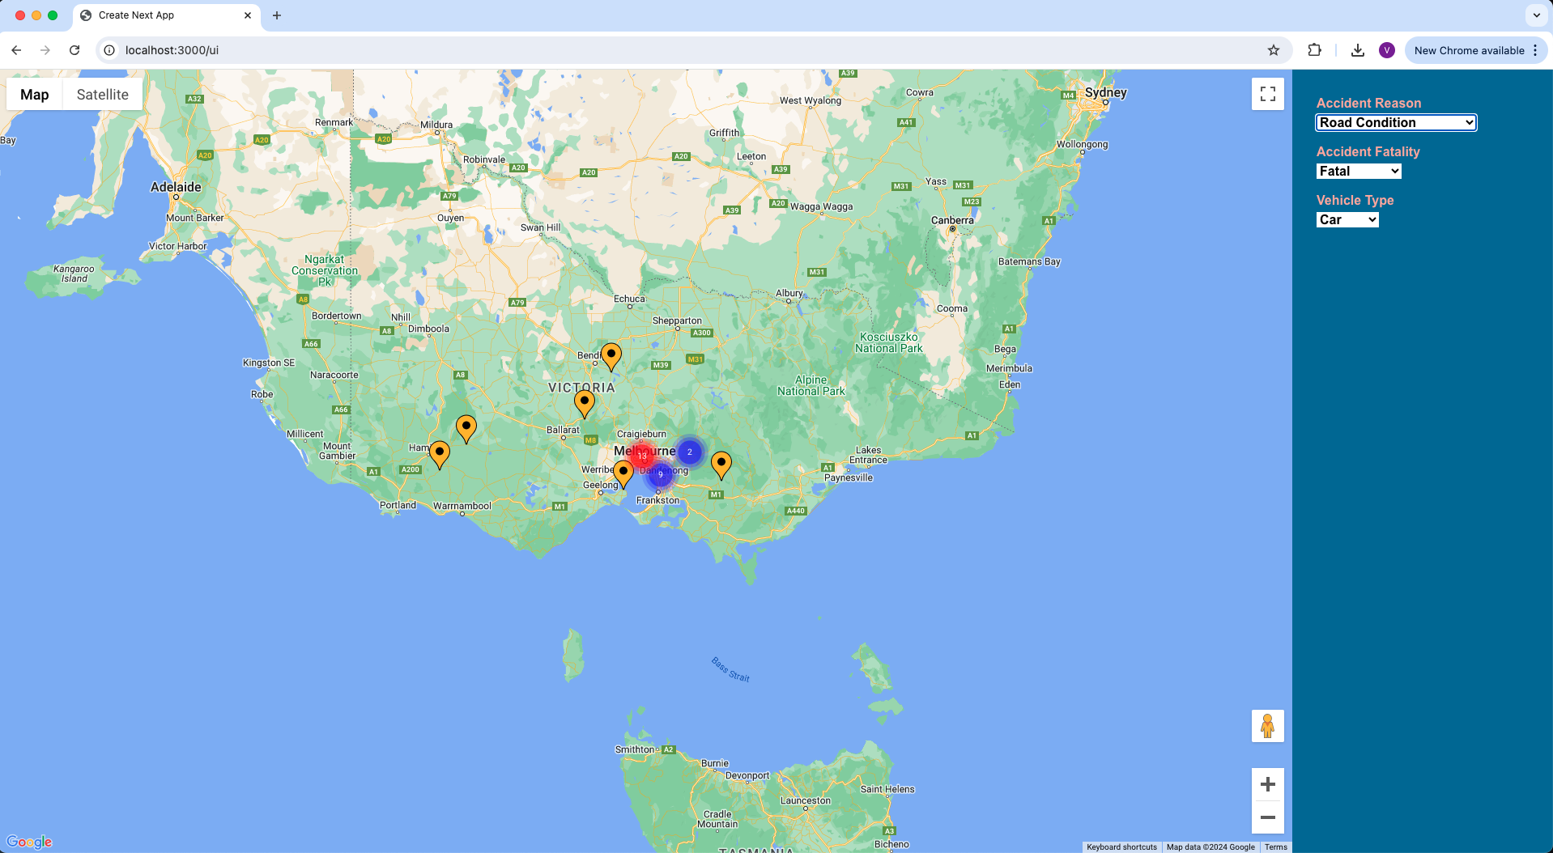

Screen Shots(Website)
On Cluster Click
Acciden Hotspots overall view
Acciden Hotspots overall view(zoom cluster 50)
On Accident Reason
Dropdown selection
Acciden Hotspots Road Condition view
Acciden Hotspots Old vehicle view

Slide 8
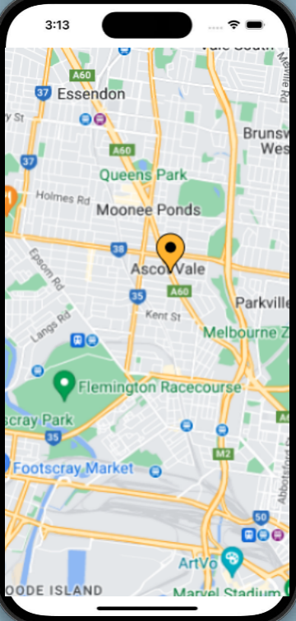
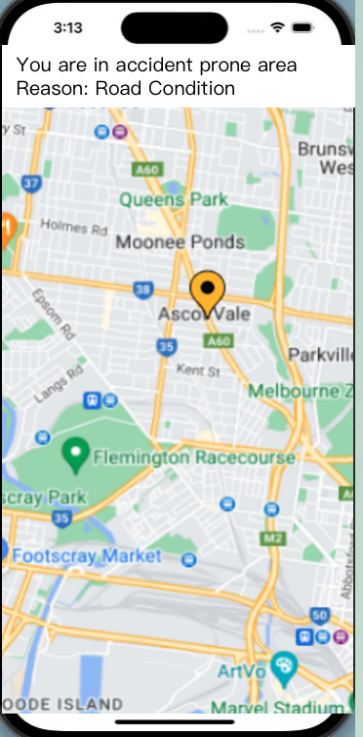
Screen Shots(Mobile)
By using geofencing the accident prone
areas, the mobile device will generate
a local notification based on user location
and risk of accidents in a location
Users real time location is
tracked by the App
When the user nears an accident spot
A local notification is received for
warning the user

Slide 9
Screen Shots

Slide 10
Impact and Benefits
RoadCrash Guard represents a significant step forward in enhancing road safety through the power of data and artificial intelligence. By addressing the critical challenges of high accident rates, human factors, infrastructure deficiencies, and environmental conditions, our solution provides actionable insights that can save lives and improve the quality of life for all road users.
Our solution leverages extensive crash data to identify high-risk areas and understand the underlying causes of accidents.
The executive briefs and recommendations generated by RoadCrash Guard offer practical solutions for policymakers, traffic management authorities, and the community.
Recommendations based on solid data can lead to the implementation of effective, evidence-based policies that enhance road safety.
Our project not only aims to reduce accidents but also fosters a safer, more secure environment for pedestrians, cyclists, and drivers alike.
Future Vision
Looking ahead, we envision expanding RoadCrash Guard to incorporate more advanced features, such as real-time accident detection, driver behaviour analysis, and integration with navigation systems. We also aim to collaborate with government agencies, research institutions, and technology partners to continuously improve and scale our solution.

Slide 11
Datasets
https://discover.data.vic.gov.au/dataset/victoria-road-crash-data
Githup link :
https://github.com/vinodache/govhack2024

